Slide 1

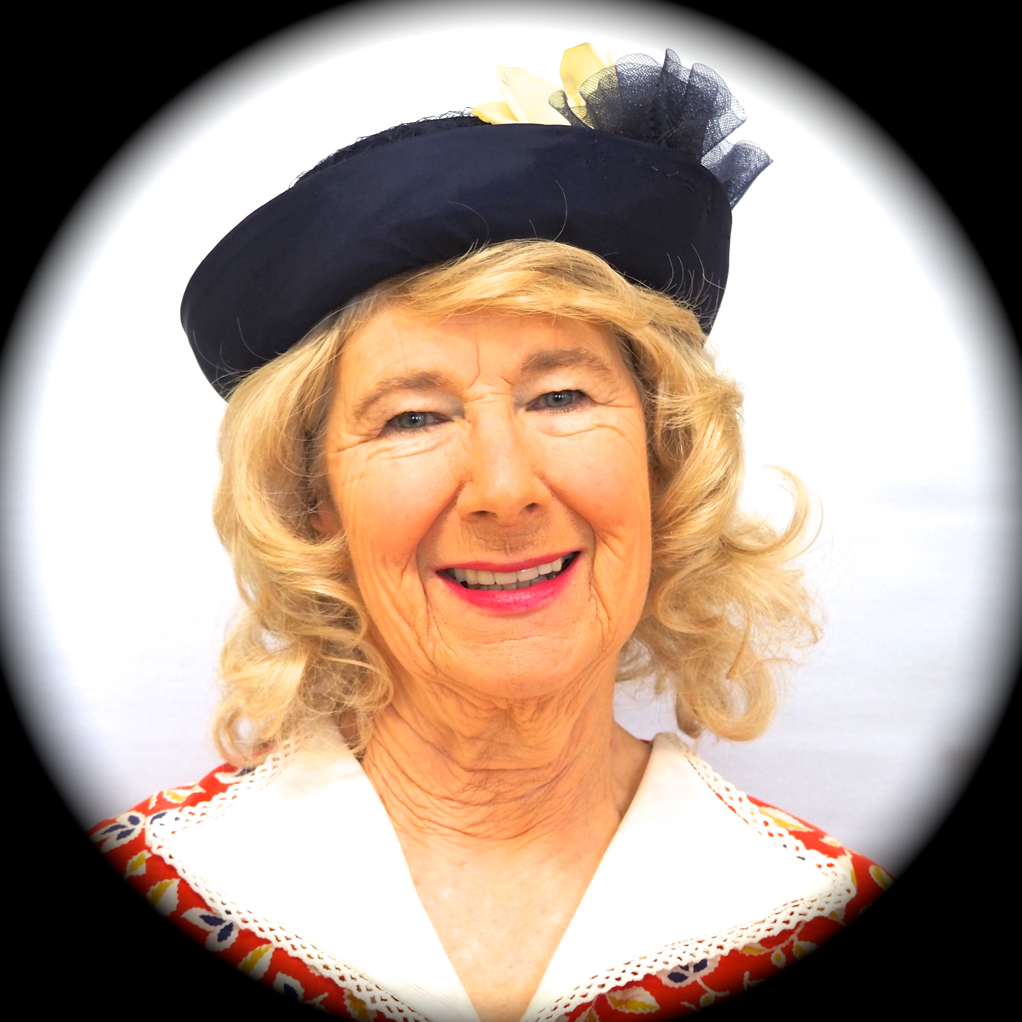
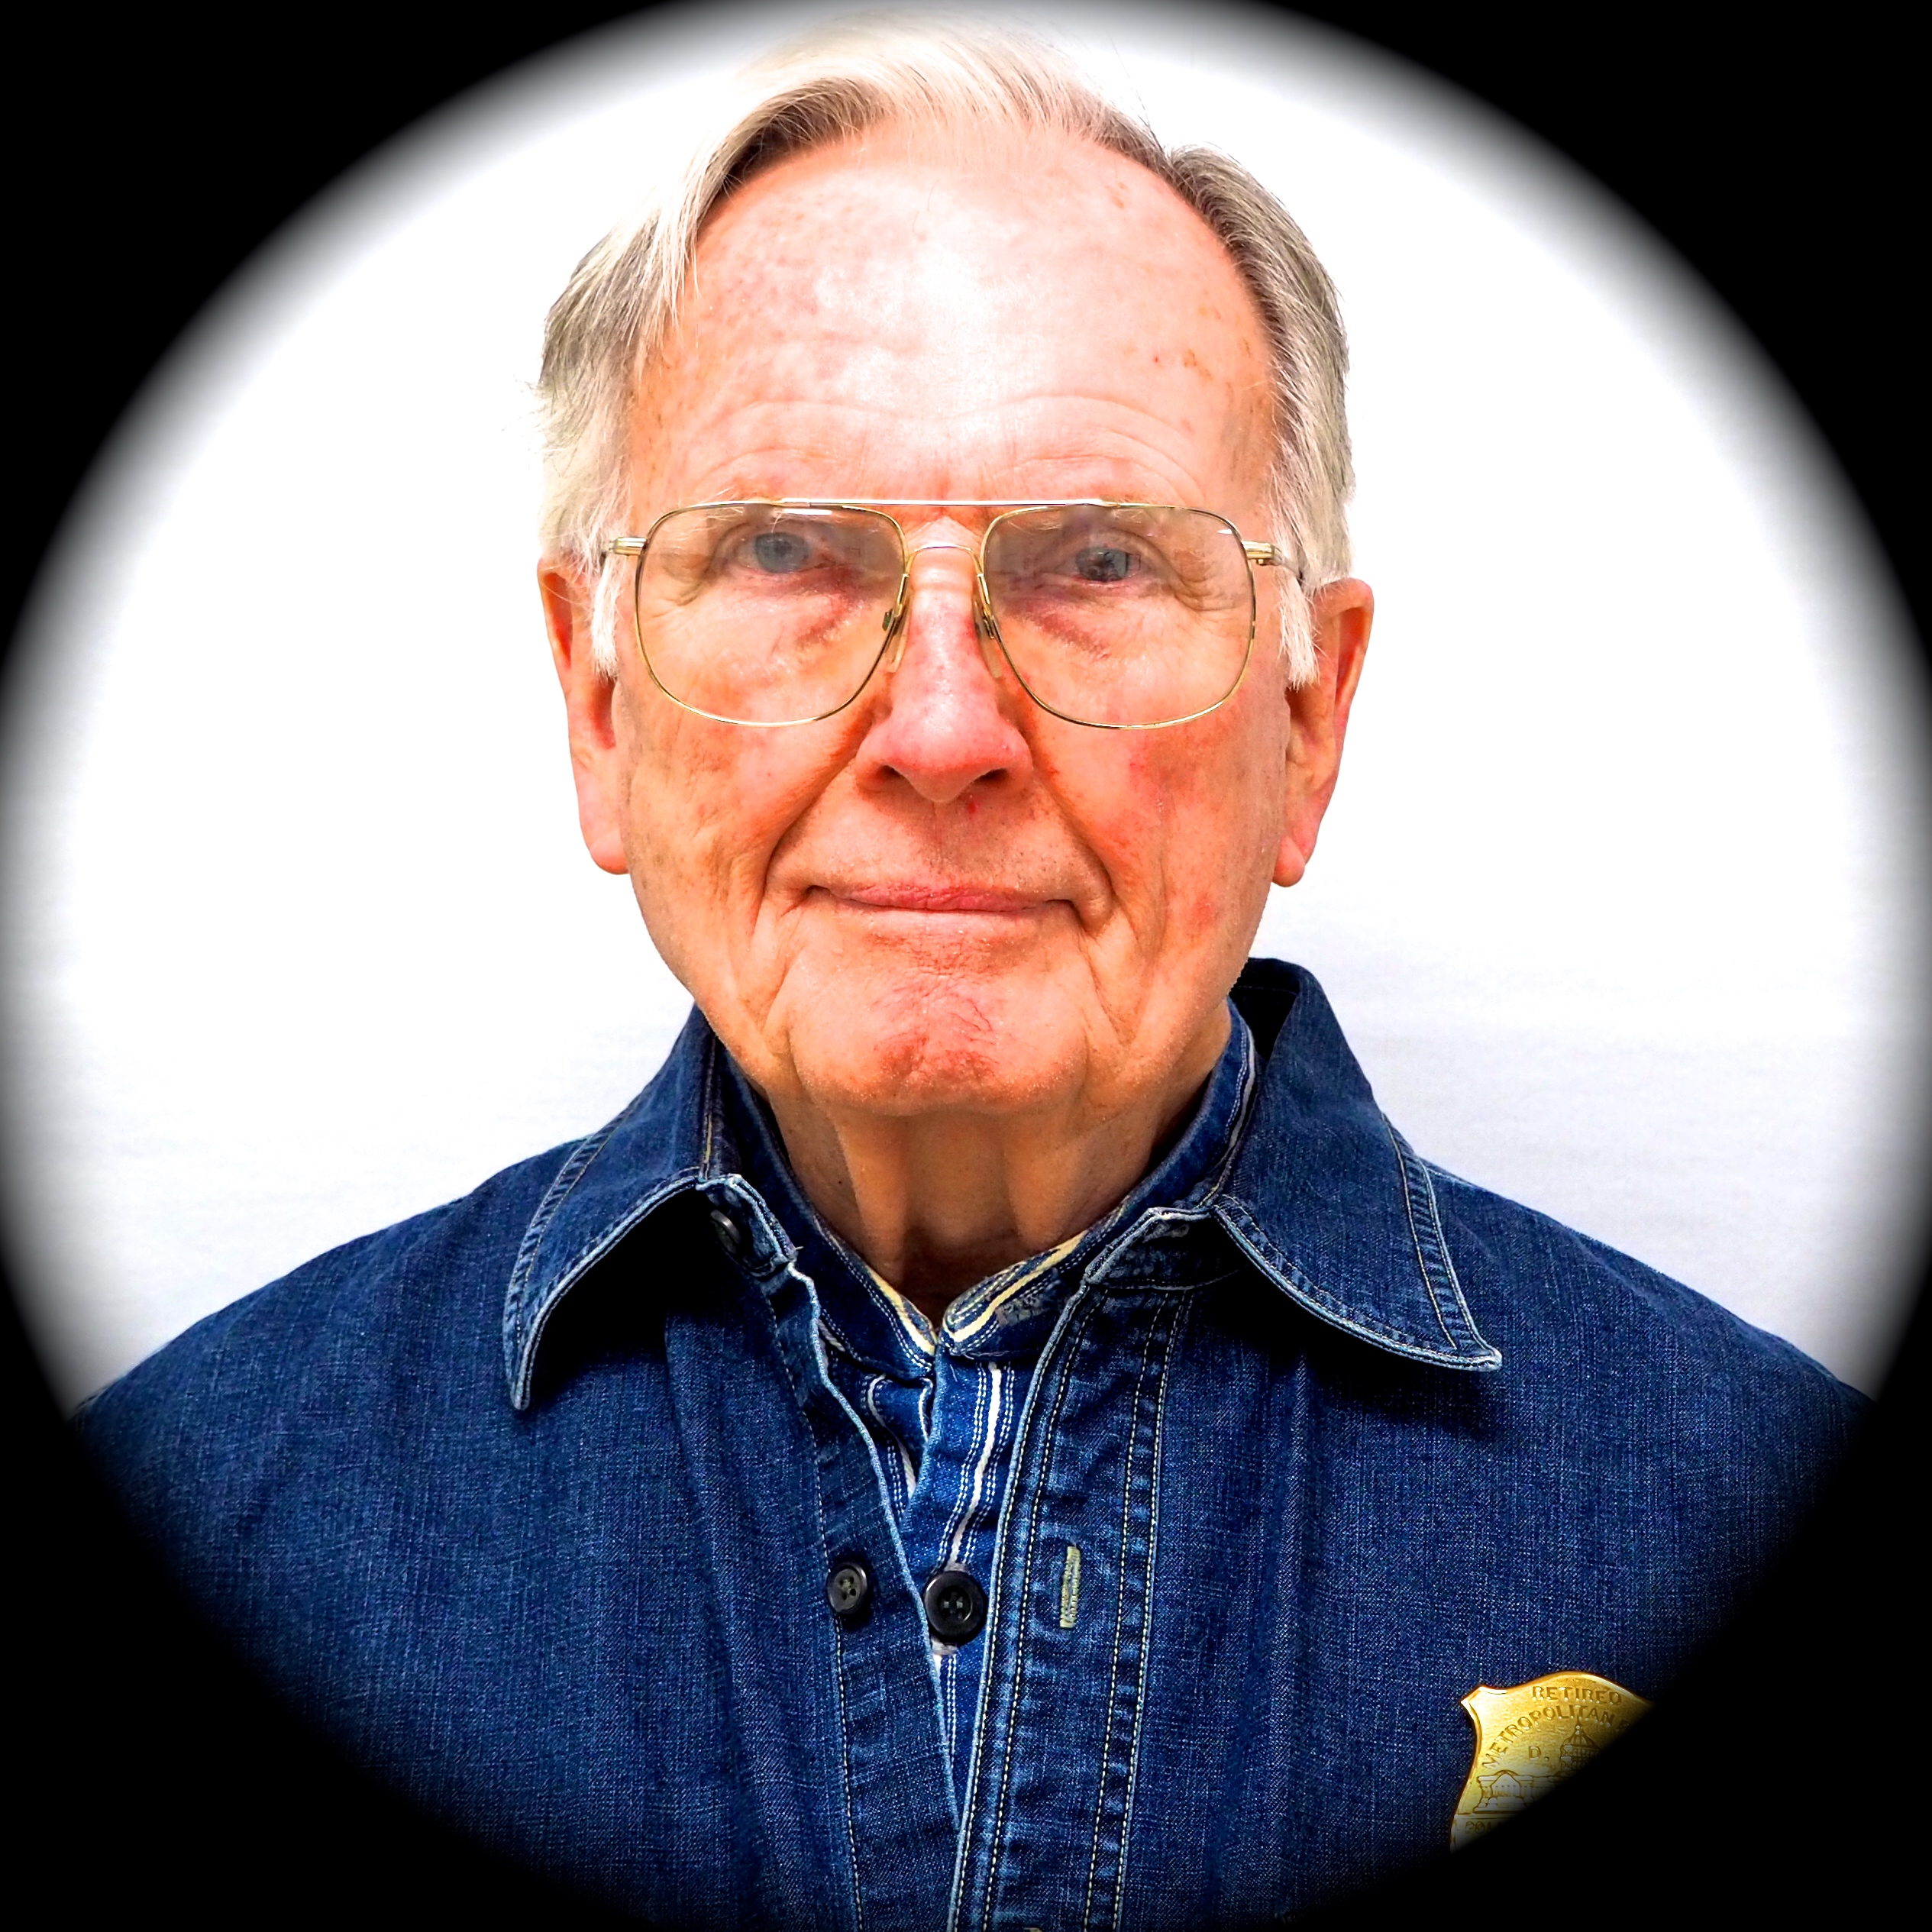

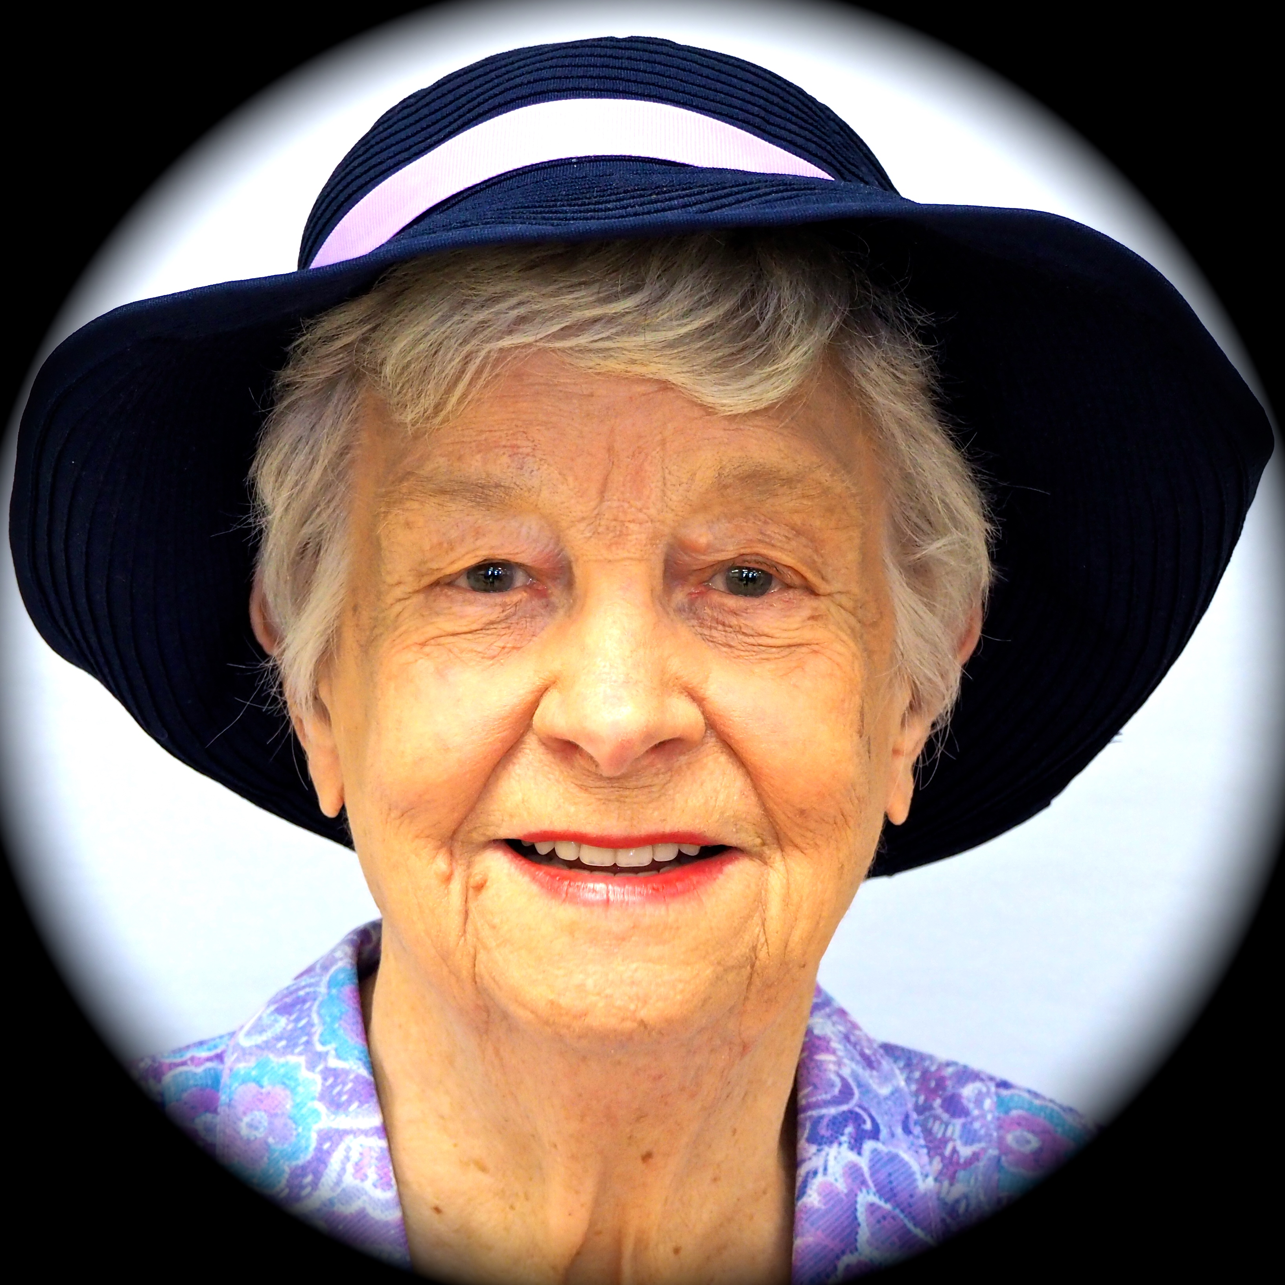
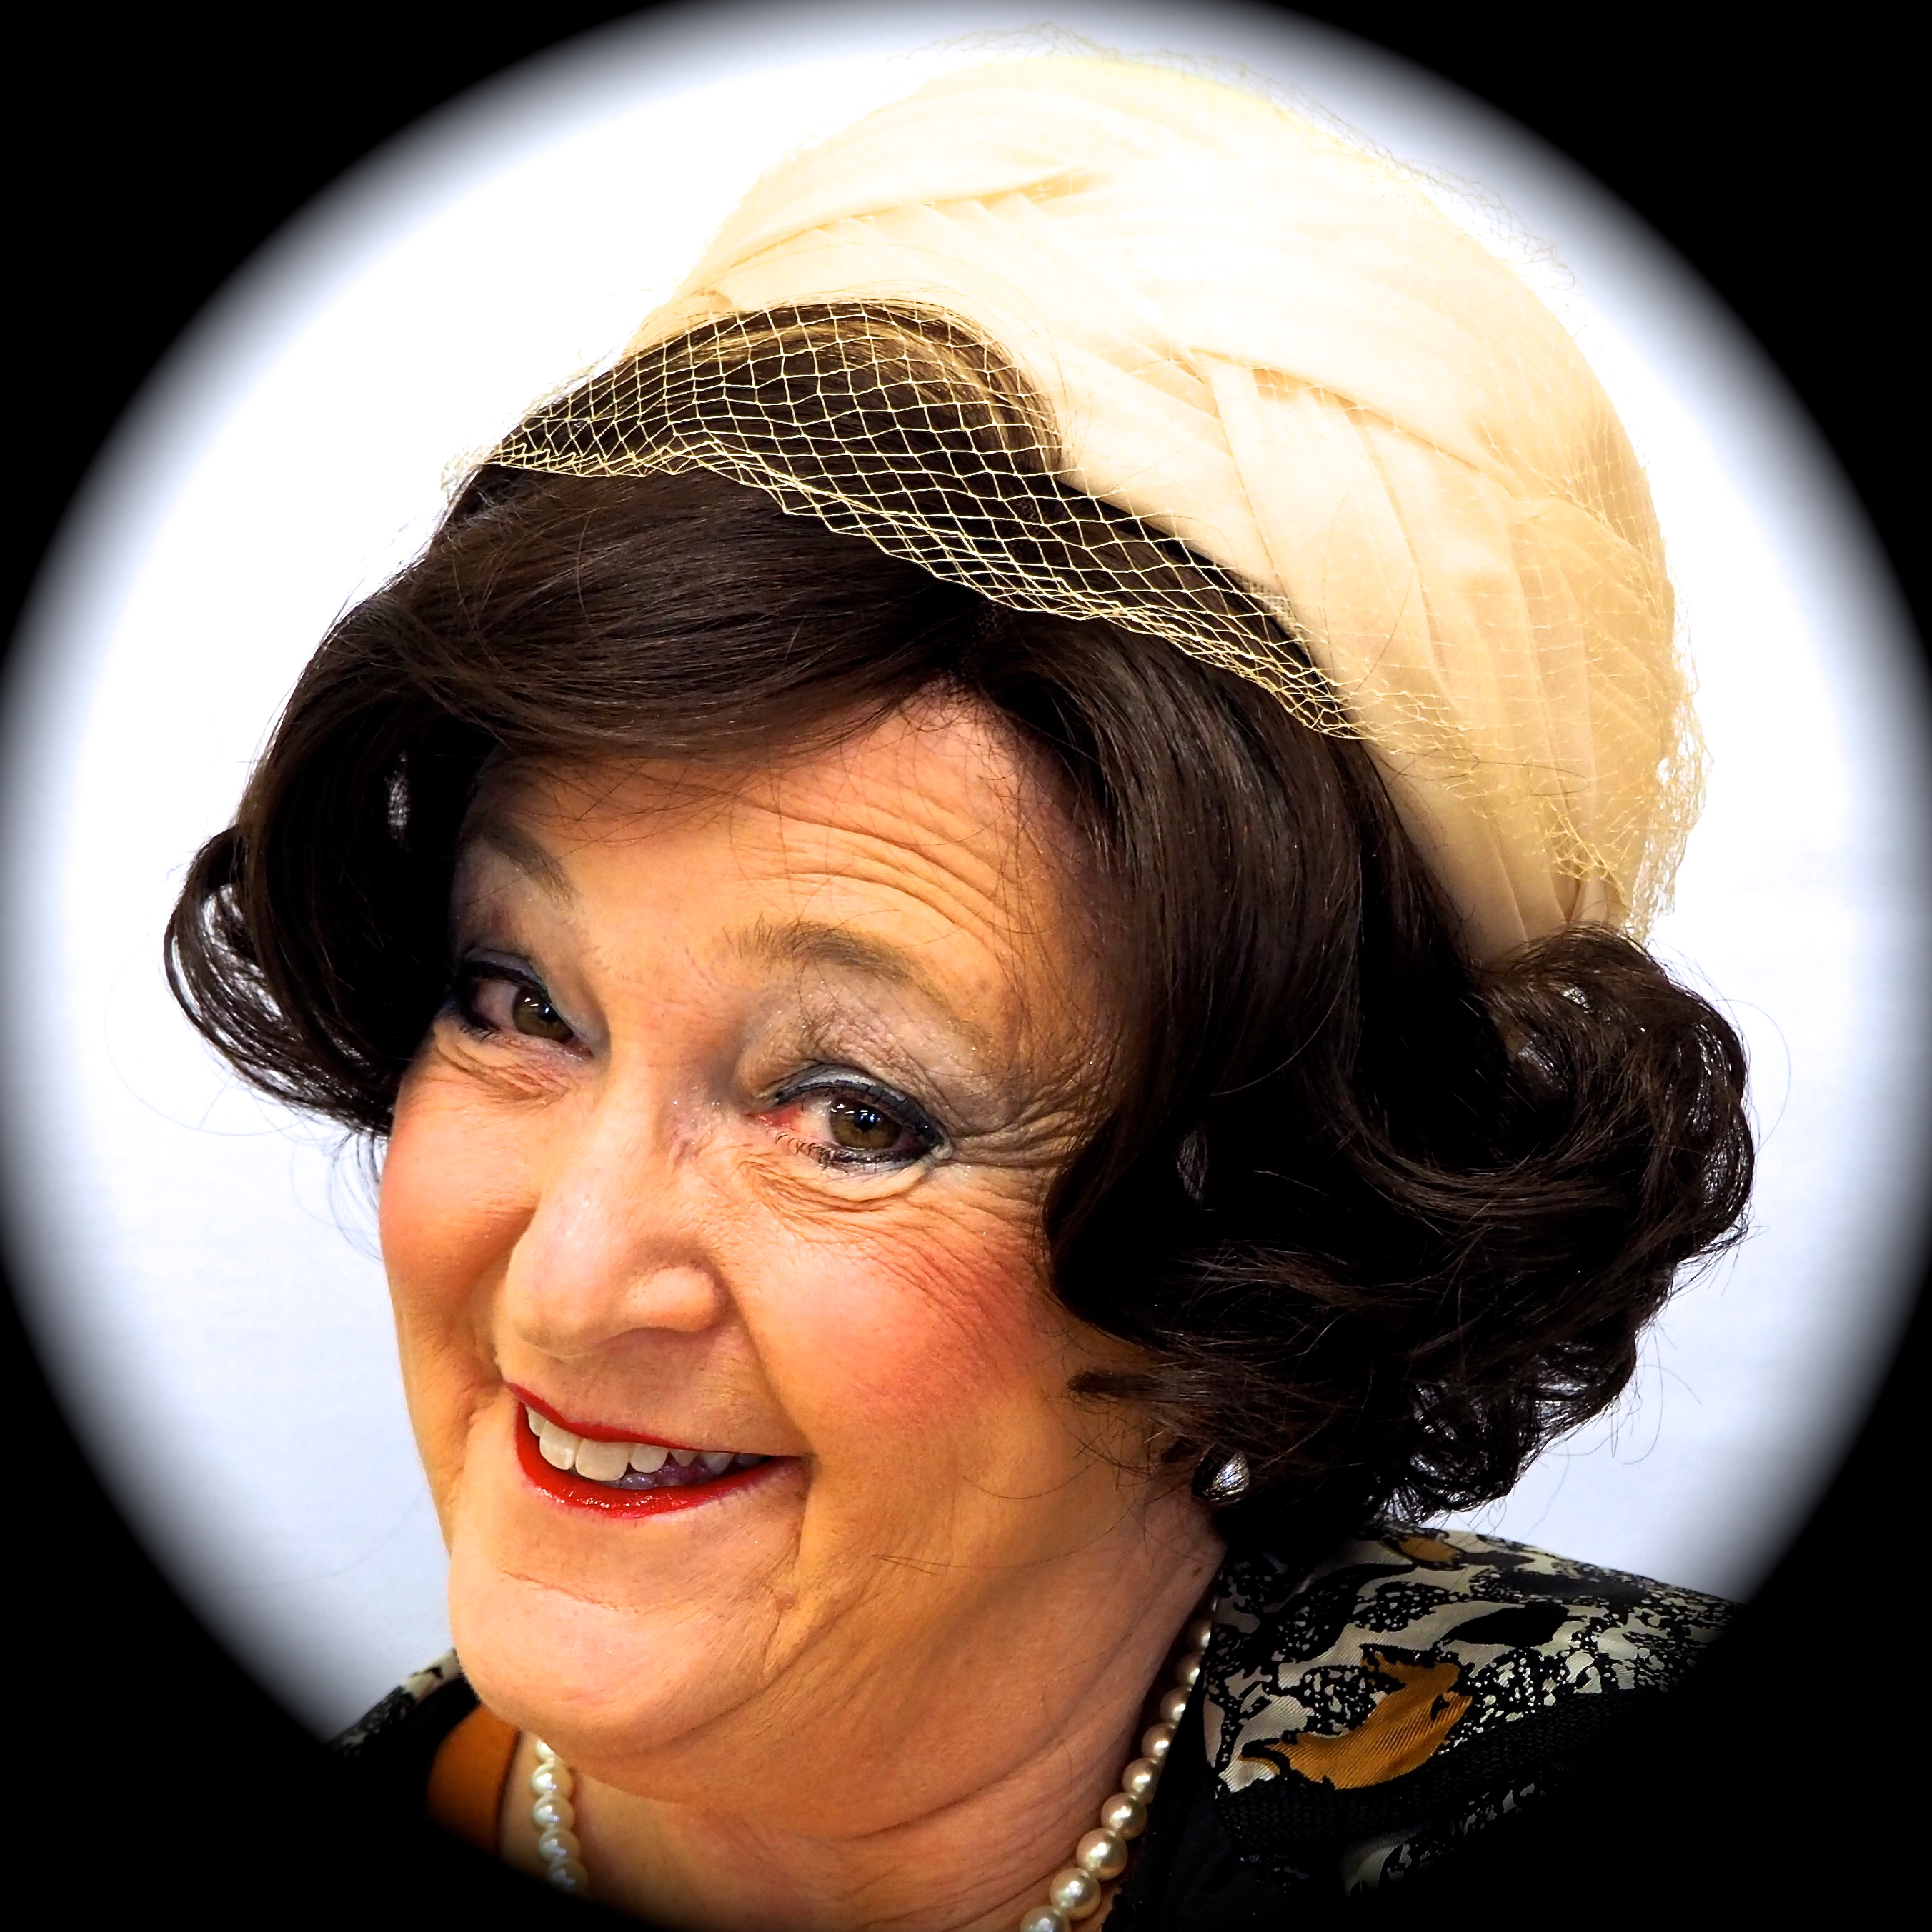
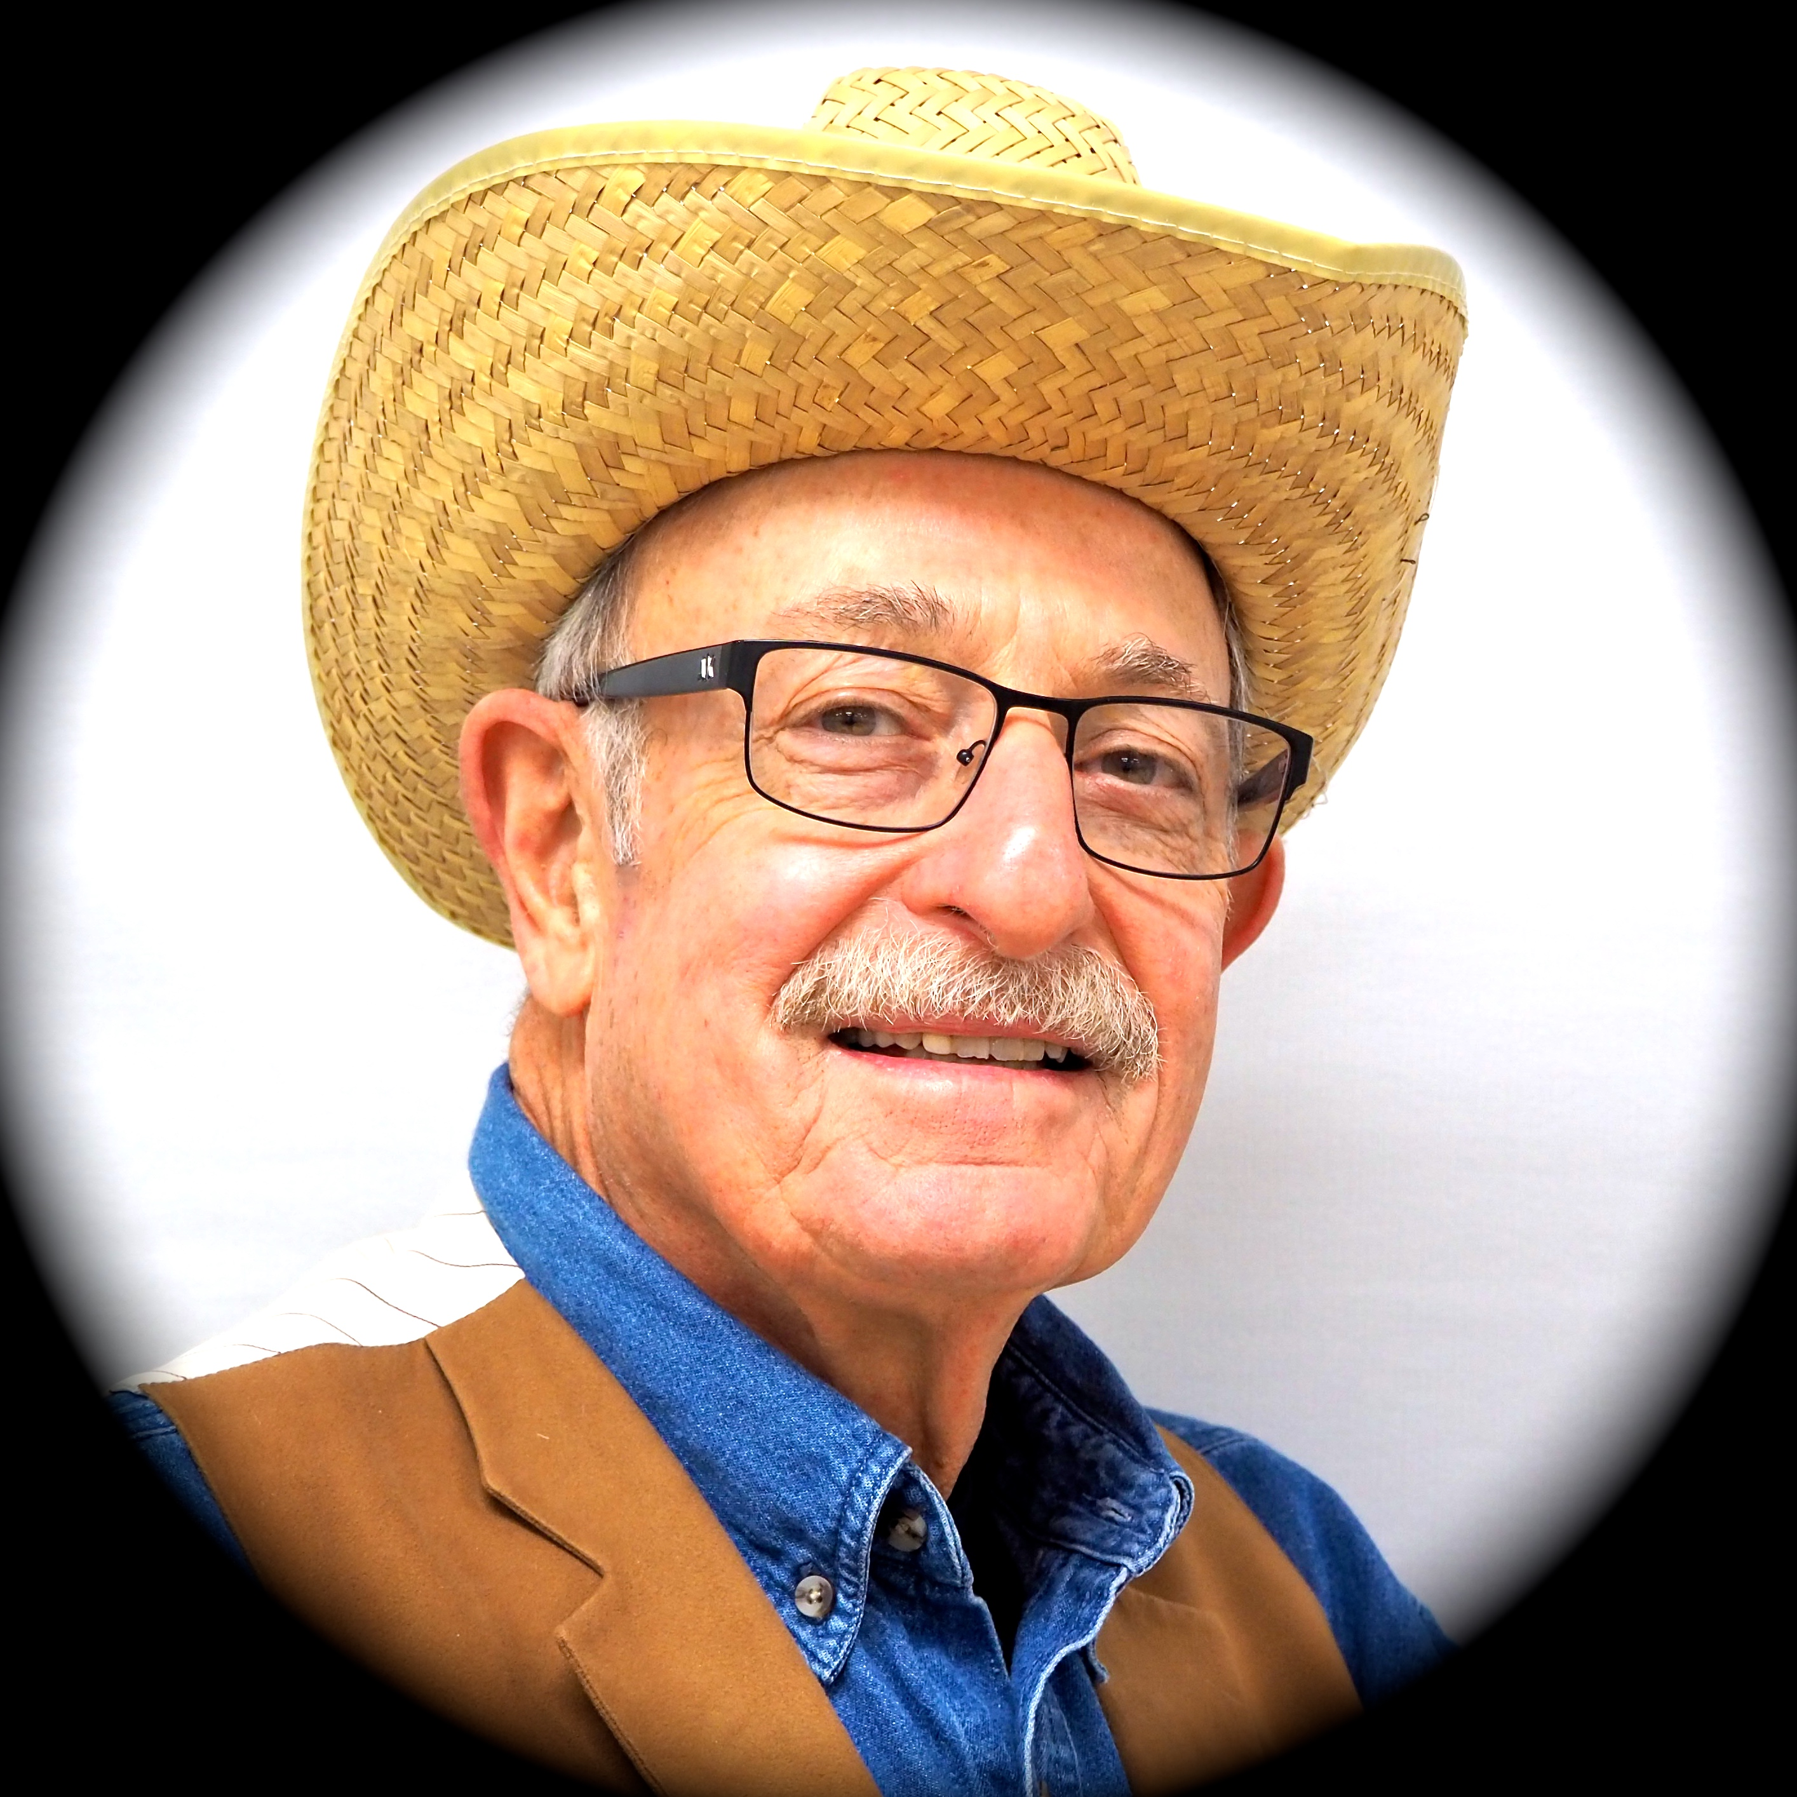

The Heritage Hunt Little Theater
Proudly Presents
The Trip to Bountiful
By
Horton Foote
Directors
Gene & Kathryn Schmiel
Producer
Andrea Mays
Sally Peterson
Jim Burwell
Tom Taggart
Dot Schuetze
Tina Mullins
Walt Meyer
Dave Jackson
April 9–11, 2019
Tuesday and Thursday Evenings * 7:00 p.m.
Wednesday Matinee * 2:00 p.m.
Doors/Cash Bar: 45 minutes before curtain.
Great Oak Ballroom * Theater Seating * $10/PP
Use the LIGHT BLUE HHLT Reservation Form
The Trip to Bountiful is presented by special arrangement with Dramatists Play Service, Inc.

